Slide 1


TANGO CORE MODEL Training users
1

Slide 2


Introduction
Connection to Tango
Tango Core Model Dimension
Tango Core Model Navigation
Data input process
Main cubes in Tango Core Model
Standard reports presentation
Reports customizing
2 •
TANGO training
Notes:
2

Slide 3
Building a shared Core Model
A common management framework, basis for management dialogue
Analytical P&L and aggregates
Operational KPIs and Work units
Definition of “activities”
A shared management axis, adapted to each country’s specific requirements
Common rules for detailed profitability and return analysis by management units supported by specific functionalities
Common processes and tool for all management phases (Actual, Budget, Forecast, Long Term Plan)
To give:
An operational dimension to financial figures
A financial dimension to operational figures
3 •
TANGO training

Slide 4


Tango Core Model collects data from local management tools and from Vector
local management / financial tools
Financial data
(All phases)
Statutory consolidation
Financial & operational data by contract and activity
Local gaap P&L / IFRS restatements / Interco eliminations
(All phases)
Metadata (Entity, currency, entity rates)
Local gaap P&L / IFRS restatements / Interco eliminations
(All phases)
TANGO CORE MODEL
… to provide
P&L aggregated
P&L by contract / activity
SG&A by function
PMM analysis
Passage social / Conso
Vector reconciliation
4 •
TANGO training

Slide 5
Structuring principles of the main Tango cube (RP_PL)
Within a cube, a data is registered at the crossing of all the dimensions which define this cube
The main Tango Core Model cube is RP_PL (Report_PL for Reporting)
Illustration:
The data is defined by 9 dimensions
Cube : RP_PL
Cell : 1 500 K€
Phase : Actual
Activity / sub-activity :
Suburban bus
P&L Indicator : Sales of
goods and OPE Indicator :
number of vehicules
Management Orga : 853-Bradley
Period : January 2016
Entity : SU1052
Currency :
Local
GAAP :
Local
Integration rate :
Applied integration rate
5 •
TANGO training

Slide 6



Tango Core Model defines multiple analytical axis
Management unis Characteristics
Management organization
Start/ End dates (with or without option)
Status
Type
Sub-Activity
Business model (PMM)
Zone
Gaap
Total conso
Country
Eliminations
Go between levels (1)
IFRS_restatements
Local_gaap
Management unit
Integration rate
Local_Gaap_Mgmt_tool
APP
LCL
KLCL
MLCL
Currency
NO_APP
EUR
KEUR
MEUR
Phase (2)
FC1
FC2
LTP
Sub-Activity
Actual
Budget
Full Year (= Forecast Vector)
Activity
Year YTD
Financial Indicators
Activity
Period
Month YTD
Entity
Month
Operational Indicators
Go between*
Entity
Country
Indicator
Data entry level
(1) “Go between “ levels (e.g. region in France, activity in Germany)
(2) Several versions possible
A data is registered at the crossing of each dimension
6 •
TANGO training
Notes:
Tango is a multidimensional tool composed of several cubes
Each data is registered :
In one cell
In one cube (each cube has at least 2 dimensions)
At the crossing between the dimensions that define the cube (each dimension is defined by attributes, hierarchies…)
Tango will become the interface for performance management in different phases (Actual, Budget, Forecast, LTP)
Tango enables sharing the same data
The data’s input, to a contract level, in multidimensional application
enables the automatic restoration of Tango restoration states and
personalized restoration states:
Less manual restatements
More time for analysis

Slide 7
Introduction
Connection to Tango
Tango Core Model dimensions
Tango Core Model Navigation
Data input process
Standard reports presentation
Main cubes in Tango Core Model
Reports customizing
7 •
TANGO training
Notes:
7

Slide 8

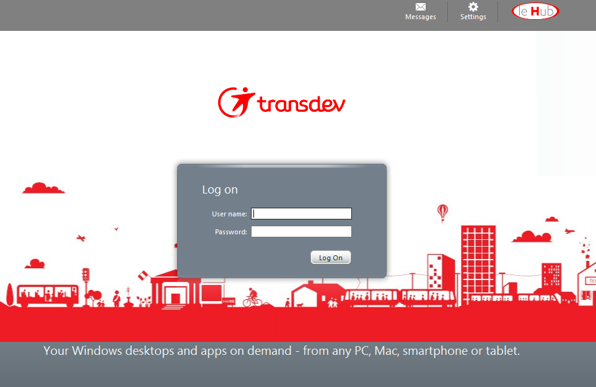
Connection to Citrix Client
Connect to this web page :
https://citrix.transdev.net/
2) Enter your Windows ID’s
User Name
Password
8 •
TANGO training

Slide 9
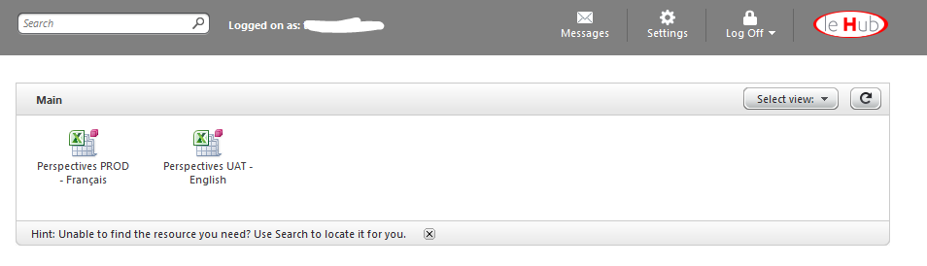
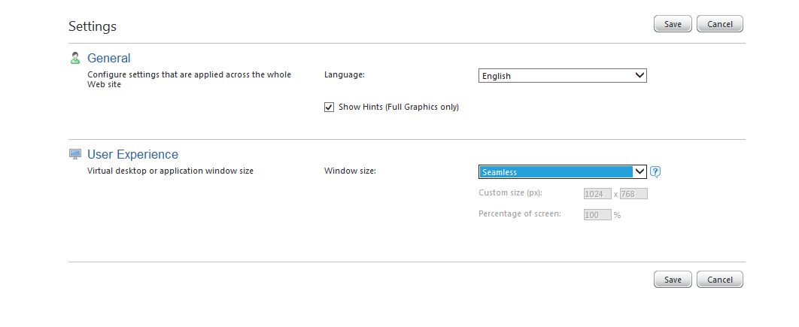
Settings of Citrix Client
(1)
(2)
(3)
We recommand you to use the option « seamless » window in settings
9 •
TANGO training

Slide 10
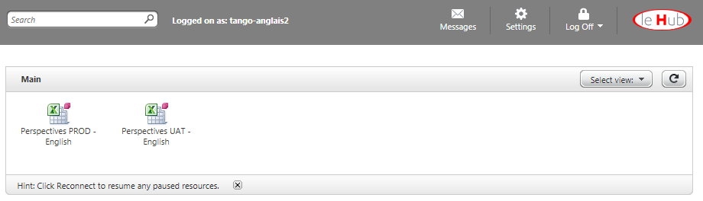
Click on the icon « « Perpectives PROD English » or « Perspectives PROD Français » to open Citrix
10 •
TANGO training

Slide 11
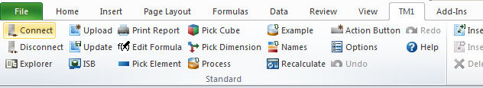
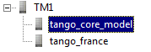
Click on the icon « Explorer » to open TM1
Double Click on the instance « Tango_Core_Model »
11 •
TANGO training

Slide 12
Introduction
Connection to Tango
Tango Core Model Dimension
Tango Core Model Navigation
Data input process
Standard reports presentation
Main cubes in Tango Core Model
Reports customizing
12 •
TANGO training
Notes:
12

Slide 13
Tango activity grid reflects VTD operational organization
Dim. Activity
Dim. GAAP
Dim. Legal Orga
Dim. Mgmt Orga
Dim. Indicators
Dim. Phase
Dim. Period
Dim. Currency
Dim. Integration rate
Dimension #1: Activity
TANGO Core Model Activities and Sub activities
Urban
National / International Bus
Management rules
Each contract has to be linked to a unique sub-activity, compatible with the activity of the legal entity
Bus
Tram
Subsidized on Demand
Metro
Paratransit
Multi-modal
Multi-modal
Cycles and car-sharing
Boat
Ferries
Suburban
Bus
Commercial On Demand
Rail
Single ride
Multi modal
Shared ride
Regional bus
Airport transportation
Schools
Airside
Regular lines
Landside
Charter / Occasional
Urban sub contracting
Other services
Heavy rail activities
Consulting / AMO
Diagnosis
Regional
Airport services
Call centers
National / International
Maintenance
Travel agency
Intermodality prest.
Purch. for resale
Activity
Holding
Digital services
Sub-activity
Specific LTP Activities Input Elements have been created to collect LTP aggregated figures
13 •
TANGO training
Notes:
13

Slide 14
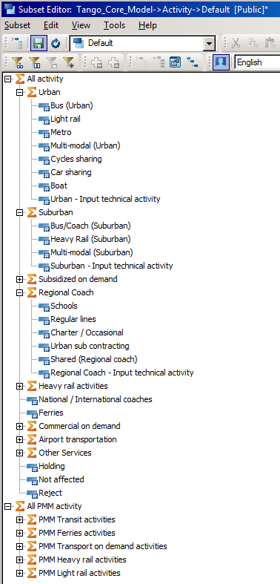
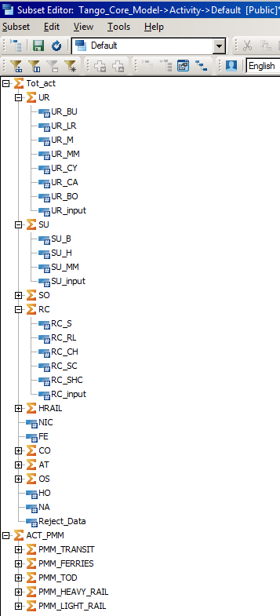
Dimension #1: Activity
Demonstration
Activity
Sub_Activity
LTP_Input
Activities
PMM Eligible
activities
14 •
TANGO training

Slide 15

Dim. Activity
Dim. GAAP
Dim. Legal Orga
Dim. Mgmt Orga
Dim. Indicators
Dim. Phase
Dim. Period
Dim. Currency
Dim. Integration rate
Dimension #2 : Gaap
Vector
Tango
Total Consolidated
Total Consolidated
Total consolidated without option - forecast and discontinued activity
Retrieve from Vector to calculate variances between Vector figures and management figures (from local management tools)
1 - Delta Vector local Gaap
2 - Delta Vector IFRS restatements
3 - Delta Vector eliminations
4 - Delta other consolidation adjustments
5 - Delta Option - Forecast
6 - Delta discontinued activities
IFRS restated
Local Gaap
Local reporting package in Vector
Local Gaap Mgmt tools
1-Delta Vector local Gaap
IFRS restatements in Vector
IFRS restatments
IFRS Restat. Mgmt tools
2-Delta Vector IFRS restat.
Eliminations in Vector
Eliminations
Others Audit ID in Vector
Eliminations Mgmt Intercos
3- Delta Vector eliminations
Option forecast ID in Vector
4-Delta Other consolidation adjustments
Discontinued activities Audit ID in Vector
5-Delta Option - Forecast
6-Delta Discontinued activities
15 •
TANGO training

Slide 16
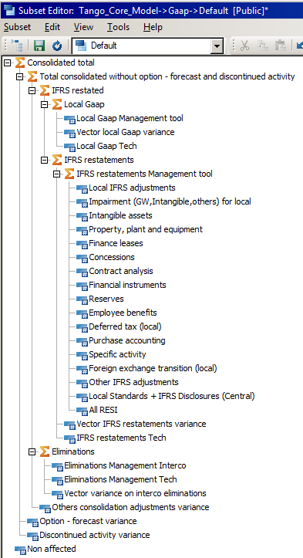
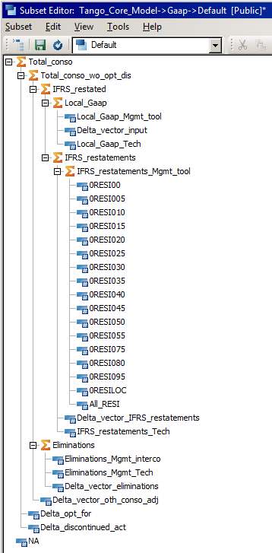
Dimension #2: GAAP
Demonstration
16 •
TANGO training

Slide 17
Dimension #3: legal organization
Dim. Activity
Dim. GAAP
Dim. Legal Orga
Dim. Mgmt Orga
Dim. Indicators
Dim. Phase
Dim. Period
Dim. Currency
Dim. Integration rate
Entities retrieved from Vector
Same levels from the Group to Go between levels as used in Management organization dimension (mostly)
Specific LTP Input Elements used to collect LTP Figures
VTD Group
Net result
Cash flow
Balance sheet
Zone
Country
5 legal characteristics are defined in the legal organization dimension (on Leafs)
Activity_Entity: one of the Sub_Activity defined ,,,
Miles : YES, [Blank] for non metric measures in USA
Code_ISO : Currency Code 3 Char
Country
Source_Entity : one of the 15 Local Data Sources
FR_SCENARIO
US_JDE
NL_TM1…..
Code_ISO : Currency Code 3 Char
Go between levels
Entity
LTP
LTP_Input
17 •
TANGO training

Slide 18
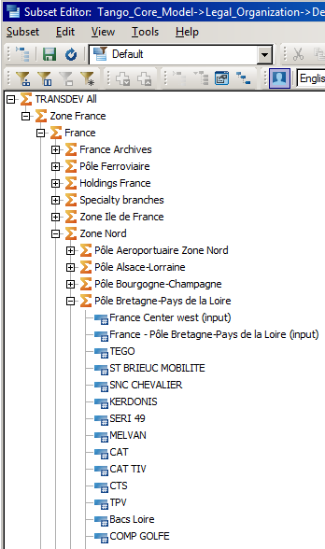
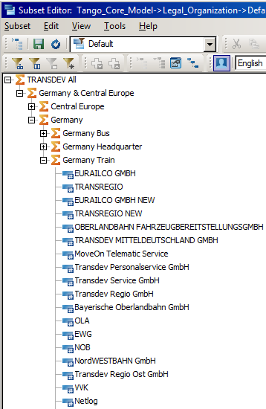
Dimension #3: legal organization
Demonstration
VTD Group
Zone
Country
Go between
Entity
18 •
TANGO training

Slide 19
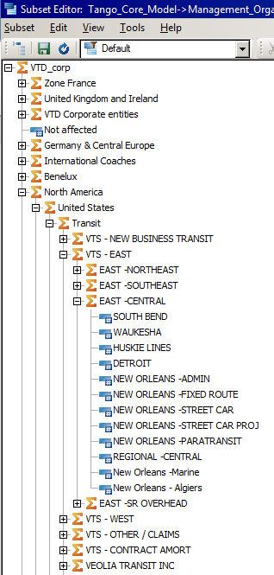
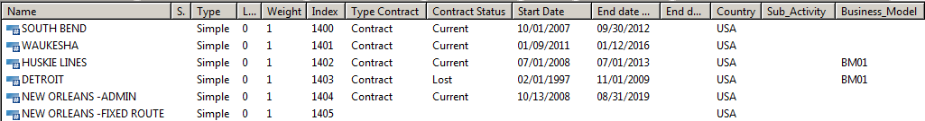
Dimension #4: Management organization
Demonstration
Dim. Activity
Dim. GAAP
Dim. Legal Orga
Dim. Mgmt Orga
Dim. Indicators
Dim. Phase
Dim. Period
Dim. Currency
Dim. Integration rate
5 management unit characteristics are defined in the management organization dimension
Type of contract: contract, contract bundle, profit center
Contract status: current, lost, internal growth, external growth
Start date
End date (with and without option years)
Sub activity
Business model
19 •
TANGO training

Slide 20
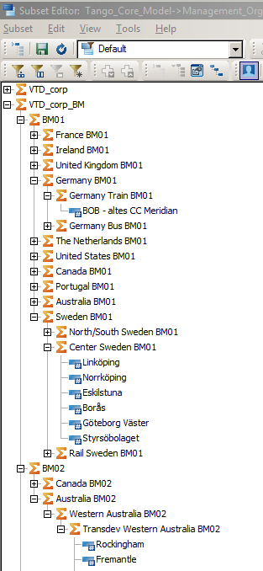
Dimension #4: Management organization
PMM
Dim. Activity
Dim. GAAP
Dim. Legal Orga
Dim. Mgmt Orga
Dim. Indicators
Dim. Phase
Dim. Period
Dim. Currency
Dim. Integration rate
A parallel hierarchy has been created to identify PMM eligible contracts
20 •
TANGO training

Slide 21
Dimension #5: Indicators
Dim. Activity
Dim. GAAP
Dim. Legal Orga
Dim. Mgmt Orga
Dim. Indicators
Dim. Phase
Dim. Period
Dim. Currency
Dim. Integration rate
Basis of both financial and operational performance analysis:
Financial indicators
Profit & Losses accounts, aggregates and ratios
Balance Sheet accounts / ratios (retrieved from Vector at an aggregated level)
Cash flow accounts / ratios (retrieved from Vector at an aggregated level)
Operational indicators
21 •
TANGO training

Slide 22





Dimension #5: Indicators Zoom on P&L elements
1
2
Revenue from ordinary activities
ROA
Three presentations for P&L Core Model:
Vector oriented view (for reconciliation purposes) ->
Tango P&L is reconciled with Vector P&L to provide “one single version of the truth”
Business oriented view (analytical)
->
Tango P&L provides analytical detail for management analysis
PMM view (analytical variance)
->
-> Reconciliation with GROSS MARGIN
Reconciliation between management data and Vector : One single “version of the truth” based on Vector data
ROA-Vector Reconciliation
ROA
Cost of sales
Subcontracted transport
Driving/operating
1
Energy for traction
Maintenance/Cleaning of fleet
Maintenance/Cleaning of Infra
Cost of damages
Customer services
2
Direct support to op.
Fleet
Infrastructure
Additional transport costs
COS-Vector Reconciliation
GROSS MARGIN
3
Business development expenses
Business dvpt expenses
COM-Vector Reconciliation
G&A
G&A Overhead costs
G&A OH-Vector Reconciliation
Management fees
G&A MF-Vector Reconciliation
Other operating rev. & exp.
Other operating rev. & exp.
OO rev.exp-Vector Reconciliation
OPERATING RESULT
22 •
TANGO training

Slide 23
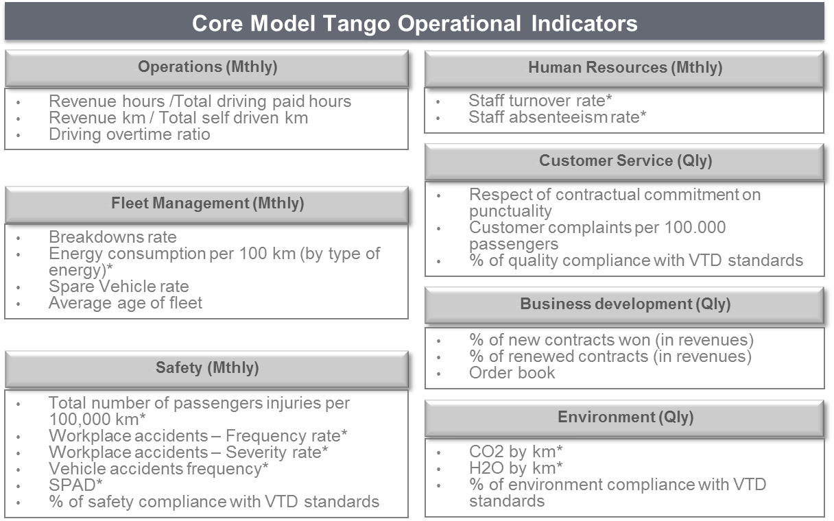
Dimension #5: Indicators Zoom on Operational indicators elements
Priority KPIs
Core Model Tango Operational Indicators
Detailed in Tango Core Model KPIs framework
Tango CM includes operational KPIs to explain operational and financial performance
23 •
TANGO training

Slide 24
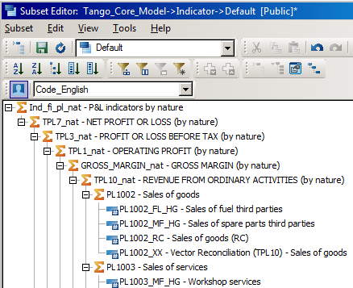
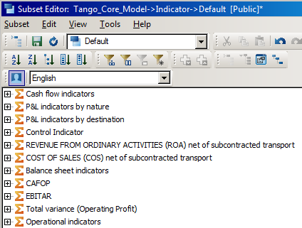

Dimension #5: Indicators
Demonstration
Main hierarchies
P&L indicators by nature
P&L indicators by destination
Cash flow indicators
CAFOP
Balance sheet indicators
Operational indicators
PMM ROA net of subcontract
PMM COS net of subcontract
Keyword : Parallel hierarchy
24 •
TANGO training
Notes:
A TM1 Dimension can have unbalanced or ragged hierarchy structure.
TM1 is able to have parallel hierarchies. It is not recommended to use this approach with an unbalanced hierarchy as the results are not what would typically be used for reporting and may cause confusion.

Slide 25
Dimensions #6 & 7 : phase and period (1/2)
Dim. Activity
Dim. GAAP
Dim. Legal Orga
Dim. Mgmt Orga
Dim. Indicators
Dim. Phase
Dim. Period
Dim. Currency
Dim. Integration rate
#6: Phase
All phases of VTD management cycle:
Actual
Budget (Versioning Current -> V0 V1 V2 -> Final)
Forecast 1 & 2 (Versioning Current -> V0 V1 V2 -> Final)
Long-Term Plan (Versioning Current -> V0 V1 V2 -> Final)
#7: Period
Monthly view of the business performance (E.g. as of September)
Cumulated view (YTD) of the business performance
From detailed to aggregated time levels
Jan | Feb | …
T1 | T2 | …
S1 | S2
25 •
TANGO training

Slide 26
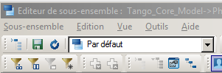
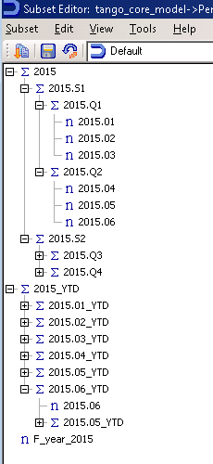
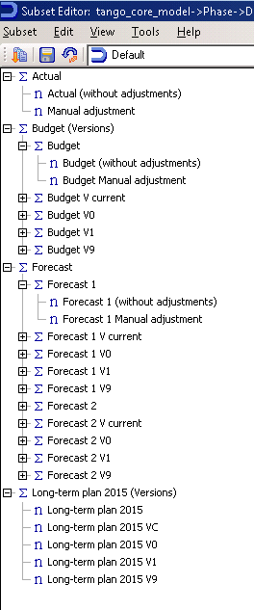
Dimensions #6 & 7 : phase and period (2/2)
Demonstration
2 Usefull Period dimension characteristics are defined in the management organization dimension (all levels)
Next Year:
For 2015.02 -> 2016.01
For 2015.02 _YTD-> 2016.01_YTD
For 2015 -> 2016
For F_Year_2015 -> F_Year_2016
Prior Year:
For 2015.02 -> 2014.01
For 2015.02 _YTD-> 2014.01_YTD
For 2015 -> 2014
For F_Year_2015 -> F_Year_2014
26 •
TANGO training

Slide 27
Dimensions #8 & 9 : currency and integration
rate(1/2)
Dim. Activity
Dim. GAAP
Dim. Legal Orga
Dim. Mgmt Orga
Dim. Indicators
Dim. Phase
Dim. Period
Dim. Currency
Dim. Integration rate
#8: Currency
Corporate consolidation currency (Euro)
Local currency (Any of VTD entities currencies)
Two rates for conversion to Corporate currency:
Average rate (P&L and Cash flow items)
Closing rate (Balance sheet items)
3 units for each currency : Currency, K-currency, M-currency
#9: Integration rate
Retrieve from Vector to calculate contribution to Transdev consolidated figures
27 •
TANGO training

Slide 28
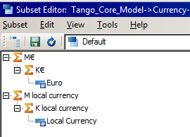
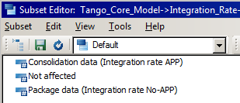
Dimensions #8 & 9 (1/2)
Demonstration
28 •
TANGO training

Slide 29
Administration of Tango Core Model
All Tango Core Model dimensions presented so far are maintained and updated by the Tango Support Team
The management organization dimension is updated through a dedicated input form (see next slide) filled by Tango Country project managers when necessary
29 •
TANGO training

Slide 30
Introduction
Connection to Tango
Tango Core Model Dimension
Tango Core Model Navigation
Data input process
Standard reports presentation
Main cubes in Tango Core Model
Reports customizing
30 •
TANGO training
Notes:
30

Slide 31
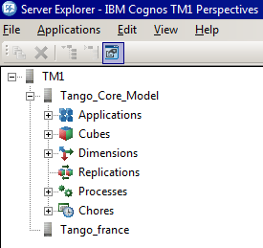
Tango Core Model Navigation
Excel / TM1 tab
The icon « Explorer » of the Excel / TM1 tab allows to open the Server Explorer – IBM Cognos TM1 Perspectives
Applications : give access to reports
Cubes : allows to display a cube and build his own view
Dimension : allows to consult all analysis axis
Processes : allows to manipulate TM1 data and metadata
Chores : allows to chain processus
31 •
TANGO training

Slide 32
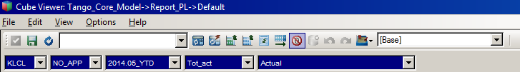
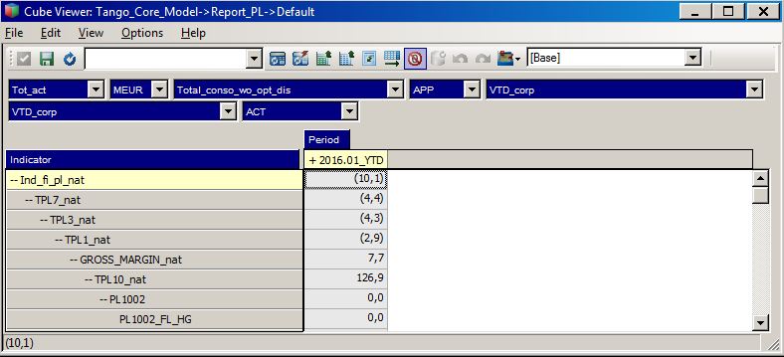
Display data in a cube view
The cube navigator provides the following functionalities to display data
Excel Extraction to snapshot, slice and active form format
Save the view
Reload the selected view
Data calculation
Deletion of lines and columns that contain 0
Display the view
32 •
TANGO training

Slide 33
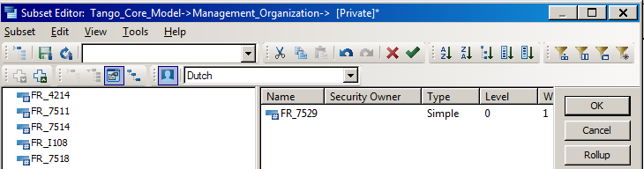

Navigate in a dimension
To navigate in a dimension, you have to double-click on a dimension of a cube. The dimension window opens itself and enables the following functionalities
Save the subset
Reload the selected Subset
Select a subset
Select / Exclude dimension Elements
Filter by hierarchy level
Filter by attribute
Search by name or code
Display unfolded of all hierarchy
Display of parent or child
Collapse / Expand of selected elements
Display of properties
Display of selected alias or code
Sorting in ascending or descending order
Sorting by hierachy
Aggregation of selected elements (in a cube view)
Before a search by name or code ( ) make sure that :
all hierarchy is displayed
codes or alias are displayed depending of your search criteria
You can use * before and/or after search characters to replace a character string
Best practice : we recommand you to display properties to navigate in Tango
33 •
TANGO training

Slide 34
Aggregate elements in a subset (1/4)
To aggregate data of elements of a dimension , you have two options :
Aggregation only in a cube view
Aggregation in a dimension
34 •
TANGO training

Slide 35
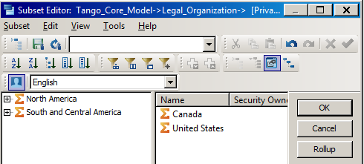
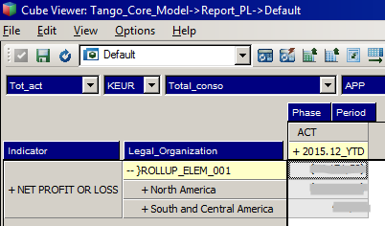
Aggregate elements in a subset (2/4)
Aggregation only in a cube view
If you only need aggregation in a cube view, you can use the button « Rollup »
35 •
TANGO training

Slide 36
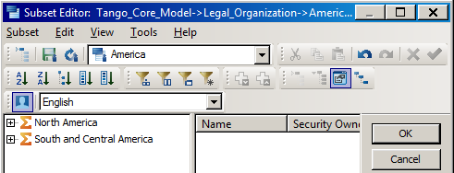
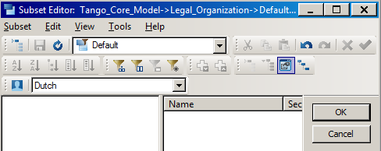
Aggregate elements in a subset (3/4)
Aggregation in a dimension
If you need to use the aggregation in many views or reports
1
Create a first subset with selected elements
2
Clear all elements of the dimension
36 •
TANGO training

Slide 37
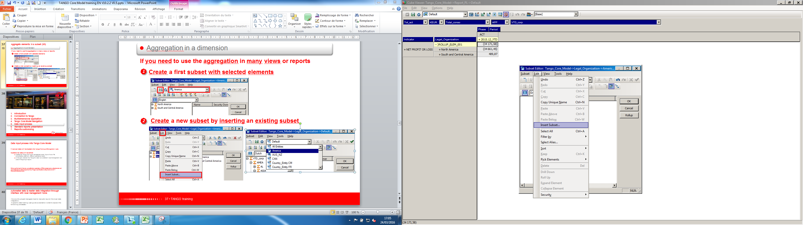
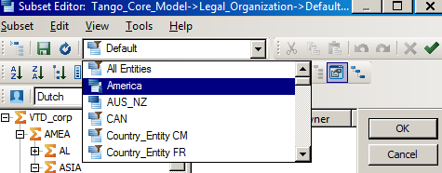
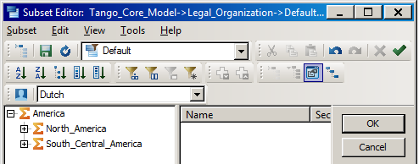
Aggregate elements in a subset (4/4)
Aggregation in a dimension
3
Create a new subset by inserting an existing subset (Edit > Insert Subset…)
4
Select the subset previously created and validate
5
Save the aggregated subset
37 •
TANGO training

Slide 38
Introduction
Connection to Tango
Tango Core Model Dimension
Tango Core Model Navigation
Data input process
Standard reports presentation
Main cubes in Tango Core Model
Reports customizing
38 •
TANGO training
Notes:
38

Slide 39
Data input process into Tango Core Model
Financial data will be loaded into Tango from Local Management tools.
Operational data will be either:
Loaded into Tango from local management tools (input of a csv file consolidating data from different operational tools)
or manually entered into Tango for data not available in local management tool (use of Tango input report)
When performed in Vector, consolidation operations (IFRS restatements, adjustments and neutralizations) will be imported into Tango Core Model at entity level and at 1st financial indicator level
39 •
TANGO training

Slide 40
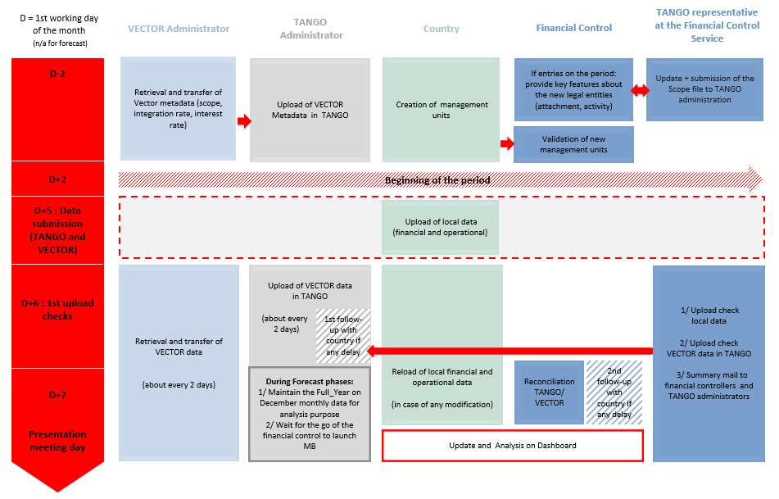
Planning process
40 •
TANGO training

Slide 41

Automated data & master data integration through interface with local management tools
The country project managers have to manually launch the local data integration.
A specific data loading user guide is available in order to explain the following processes :
Manual launch of interface (data extraction file)
Analysis of reject log (P&L and management unit issues)
Correction of errors (mapping defect, CSV file format or content defect, process defect)
Reload of data extraction file
Tango data quality is under the country’s responsibility
Please refer to the country project manager for any update
41 •
TANGO training

Slide 42



Data is expected in Tango CM format and at the lowest level of each dimension
Legal organization → Vector entity code (e.g SU7603)
Management Organization → Management unit code (to be created into Tango)
Activity → Sub-activity code (e.g UR_BU)
Indicator → financial or operational indicator lowest level code (e.g. PL1110_DO_10)
Gaap → Local_Gaap_Mgmt_tool for 0LOC01 figures, 0RESIXXX for IFRS restatements in local management tool
Phase → ACT for Actual, BUDG_VC for Budget, FC_1_VC for Forecast 1 and FC_2_VC for Forecast 2
Period → YYYY.MM_YTD (e.g. 2015.06_YTD, 2015.07_YTD)
Country has to produce .csv files that will be loaded into Tango by Core Model HQ administrator through a dedicated TM1 process (see the format of the .csv file next slide)
Country responsibility
Core Model HQ administrator
Extraction
Transformation
Loading
TANGO
Core Model
From local tools
Mapping and transformation in Tango format
Data loading through a TM1 process
An additional option is available for operational indicators thanks to a dedicated standard input report
42 •
TANGO training

Slide 43
Presentation conventions
Tango sign convention
Sign convention - ( ) is used for costs, liabilities, cash outflows and adverse variances
Countries will extract data from their local tool according to this convention
Tango will display the data according to this convention for all countries
Values
By default, amounts are displayed in K€ or K-Local currency
Display by € / local currency and M€ / M Local currency will also be available
43 •
TANGO training

Slide 44
Input of a new management unit: presentation
Input report for new management unit creation is composed of different fields for management unit definition, mapping and transcodification:
Country/region
Mapping information (code in local tool)
Start date
End date without options
End date with options
Status
Legal organization
Activity
Type of client
Economic model
44 •
TANGO training

Slide 45

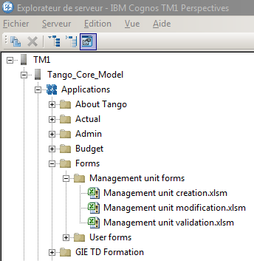
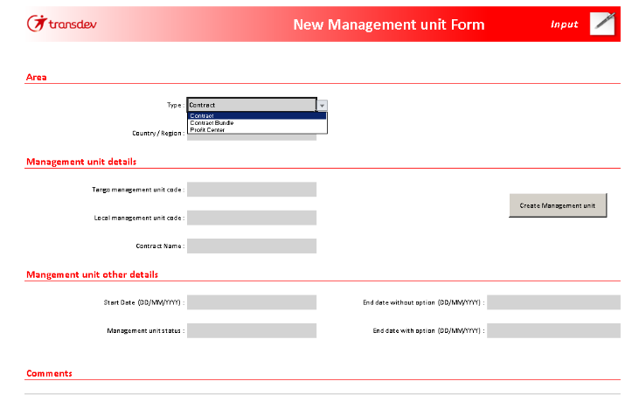
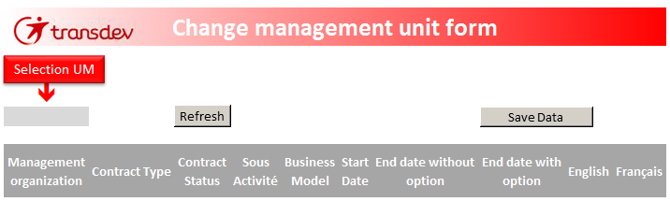
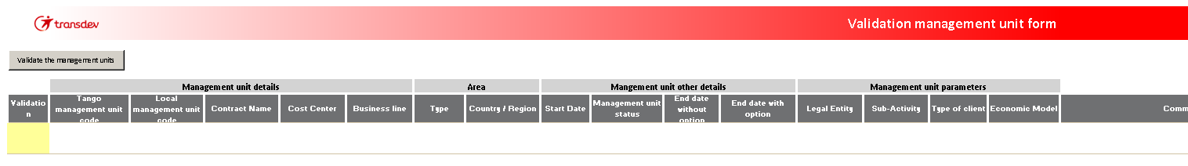
Exercise : Input of a new management unit (1/3)
EXERCISE
1
Open TM1
2
Open the tree
folder (applications)
3
Click on the folder « Management unit form »
4
Double click on « Management Unit form »
Submission –
Local Project Manager
Validation – Regional Corp Controler
Modification –
Local Project Manager
45 •
TANGO training

Slide 46
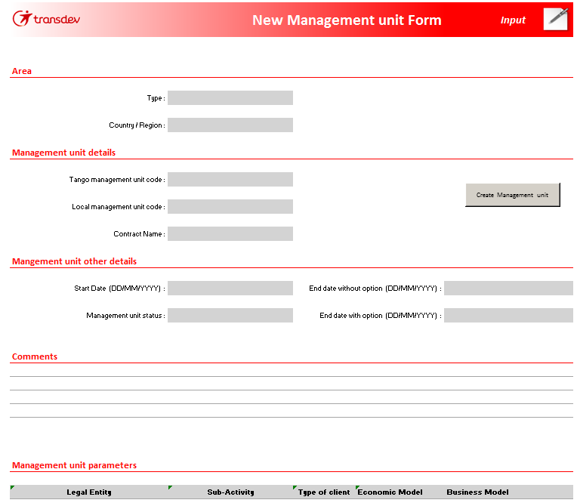
Exercise : Input of a new management unit (2/3)
EXERCISE
1
Definition of the area
2
Definition of the management unit details and characteristics
Create Management unit
5
3
Input of comments
4
Selection of management unit parameters
The management organization dimension is automatically updated through this report
All management unit characteristics have to be filled
Naming convention for Tango Mgmt Units eg : US_199 FR_4091
46 •
TANGO training

Slide 47
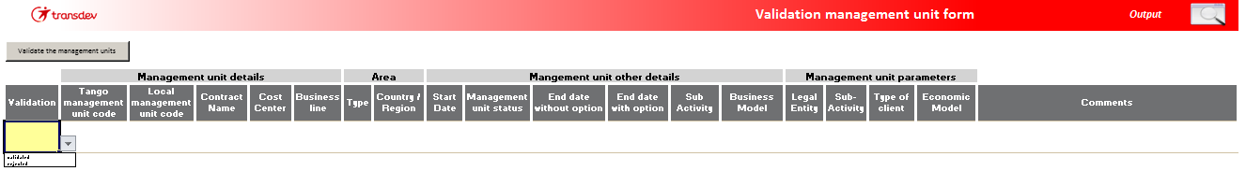
Exercise : Input of a new management unit (3/3)
EXERCISE
Once the management unit is created, the Corporate controller has to validate/reject the new management unit in a specific report :
Validation management unit form
✓

47 •
TANGO training

Slide 48
Exercise : Update of a management unit
EXERCISE
1
Double click to select a management unit or a go between
Save Data
3
2
Update of the management unit details and characteristics
The management unit characteristics are automatically updated through this report
If you change the business model, you need to ask the Performance team to update the PMM management organization
48 •
TANGO training

Slide 49
Introduction
Connection to Tango
Tango Core Model Dimension
Tango Core model Navigation
Data input process
Standard reports presentation
Main cubes in Tango Core Model
Reports customizing
49 •
TANGO training
Notes:
49

Slide 50


A report library by topic (1/2)
P&L reports :
Management reporting (aggregated reports for managers)
Business review package as defined by Transdev
Main financial KPIs (e.g. Operating Cash flow – CAFOP)
Operational KPIs
Vector reconciliation report
Controlling Reporting (detailed reports to zoom when necessary)
One detailed report for each P&L aggregate (ROA, Driving/operating, maintenance, G&A…)
LTP reports
Input reports
Management reports
1
Corporate controllers
Country controllers
Local management
Entity management
Excel interface
50 •
2
50 •
TANGO training

Slide 51
A report library by topic (2/2)
Forms
Management unit forms
Creation and modification of management units
PMM reports
Gross Margin variance, cumulated effects DMEFO
Presentation template
EBIT by contract
3
Corporate controllers
Country controllers
Performance analysts
Local management
Entity management
Excel interface
4
51 •
51 •
TANGO training

Slide 52

Static / Dynamic reports to drive better decision-making
IBM Cognos TM1 delivers real-time analytics feedback
Static Report
Ability to select the scope of data analyzed (Context)
Data importation process via Action buttons (if needed)
Intuitive Excel-based Formatting
Ability to customize Corporate Reports with local needs
Dynamic Report
All functionalities of Static report
Capability to drill-down / drill-up rows → Data Consolidation
Capability to deliver Top Count types reports
Multi-dimensional Analysis
Dynamic navigation into datas
Ability to perform ad-hoc queries
Ability to produce new reports
52 •
TANGO training

Slide 53
Context selection rules
Two dimensions in Tango Core Model leading to 2 different views
Legal dimension for a Vector reconciliated view
Management dimension for a business oriented view (without Vector variances)
Regarding GAAP, Integration rate and Currency dimensions, the only relevant crossing in Tango are:
In order to have a Vector reconciliated view in the reports, you have to select the highest level in the management organization dimension (VTD_Corp) and the adequate level in the legal dimension
Dimensions |  |  | Correspondance
GAAP | Integration rate | Currency
Local GAAP or IFRS restated | Non applied | Local | Vector package data
Total consolidated (wo option forecast & discontinued activities) | Applied | EUR | Vector consolidated data
Total consolidated (wo option - forecast & discontinued activities) | Applied | Local | Business review – bridge input Vector consolidated data converted
53 •
TANGO training

Slide 54
How the dimensions are analyzed in a report?
1. Dimensions in context
Selection of the scope of the data analyzed : organization, activity….
Dimensions in context
Reporting presentation
Dimensions in columns
3. Dimensions in columns:
Usually phases and periods (+Variances calculation)
Dimensions in lines
Data
2. Dimensions in lines:
Usually financial and operational KPIs
54 •
TANGO training

Slide 55
Introduction
Connection to Tango
Tango Core Model Dimension
Tango Core Model Navigation
Data input process
Standard reports presentation
Main cubes in Tango Core Model
Reports customizing
55 •
TANGO training
Notes:
55

Slide 56






Main cubes in Tango Core Model (1/2)
Main cube with actual and Budget / Forecats data
Cube used for reporting on actual and bdget/forecast data. It’s a copy of RP_PL
Cube with data retrieved from Vector
Main cube with Long Term Plan data
Cube used for reportings on LTP data. It’s a copy of RP_LTP
Parameter cube with work units used in PMM ratios, by country, PMM activity and PMM business model for DMEFO
56 •
56 •
TANGO training

Slide 57




Main cubes in Tango Core Model (2/2)
Cube to control loading status of the data files
Cube listing the possible rejects of data loading
Cube to control authorizations for loading status on the crossing legal entity / management unit / sub-activity
Cube listing the possible rejects of unauthorized data loading
57 •
57 •
TANGO training

Slide 58
Introduction
Connection to Tango
Tango Core Model Dimension
Tango Core Model Navigation
Data input process
Standard reports presentation
Main cubes in Tango Core Model
Reports customizing
58 •
TANGO training
Notes:
58

Slide 59
Tango customization
In order to perform specific analysis (in Excel TM1 only), Tango enables :
Building and managing cube views
Extracting data in Excel through 3 different ways
Snapshot (only value : can’t be refreshed)
Slice (with TM1 formula : can be refreshed)
Active form (with TM1 formula, allows to expand and collapse row dimension)
59 •
TANGO training

Slide 60
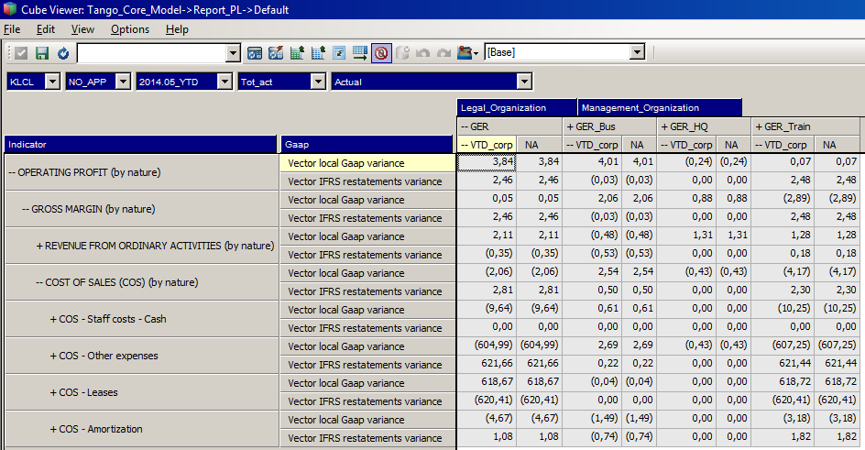
Building a cube view
The building of a cube view is defined by
The dimensions disposition : context / lines / columns (same way as a pivot table)
The choice of elements to display within each dimension
Dimensions in context
Dimensions in column
Dimensions in line/rows
60 •
TANGO training

Slide 61
Dimensions manipulation in a Cube View
Using the Cube Views as a pivot table report
In a Cube View, you can manipulate the dimensions as in an Excel Pivot Table report.
To do so, you need to know the cursor various displays.
Legend :
Moving a dimension in Context Also display the context dimension name and subset
Dimension insertion between to existing dimensions
Add a dimension in Column when no column dimension exists
Add a dimension in Rows when no Row dimension exists
61 •
TANGO training

Slide 62
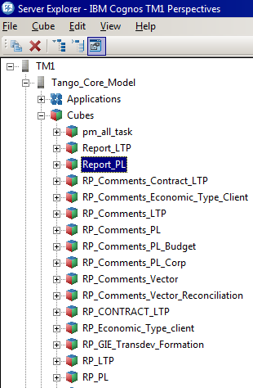
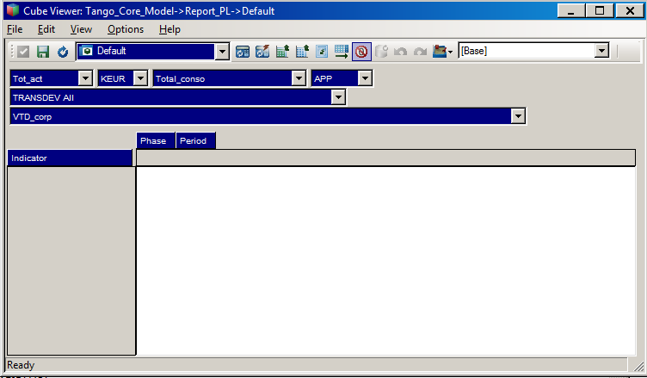
Open the Report_PL cube
1
Open TM1
2
Open the tree folder (cubes)
3
Double click on Report_PL
4
The cube opens itself on a default view
62 •
TANGO training

Slide 63
Tango customization
In order to perform specific analysis (in Excel TM1 only), Tango enables :
Building and managing cube views
Extracting data in Excel through 3 different ways
Snapshot (only value : can’t be refreshed)
Slice (with TM1 formula : can be refreshed)
Active form (with TM1 formula, allows to expand and collapse row dimension)
63 •
TANGO training

Slide 64

Extraction in snapshot format
The extraction in snapshot format enables to provide a data board in value and has no link with Tango.
Use: Export in value for a person who does not have access to Tango
Advantages | Drawbacks
Export data in value Direct work on data for a person who does not have Tango | No dynamism
64 •
TANGO training

Slide 65

Extraction in slice format
The extraction in slice format enables to extract a board whose format is fixed and data fed and updated by Tango
Use: Synthesis reporting on aggregates
Advantages | Drawbacks
Data automatic update by Tango Easily adaptable | Fixed board format Not available for a person who does not have Tango
65 •
TANGO training

Slide 66

Extraction in active form
The export in active form enables to extract a dynamic board: data and names are updated with Tango
Use: recurring analysis to different granularity levels
Advantages | Drawbacks
Automatic update of data by Tango Automatic update of names by Tango Management facilitated by the format of the board Navigation in dimensions (use of + and - ) | Not accessible to a person who does not have Tango
66 •
TANGO training

Slide 67
Exercise : Creation of a cube view
Objectives : create a specific cube view ➔ VTD Germany / Operating Result / Actual Décember 15
Currency: LCL (Local currency)
Integration rate: NO_APP (non applied integration rate)
Phase: ACT (Actual)
Management organization: VTD
Legal organization: Germany
Activity: All_activity
Period: 2015.12_YTD (YTD december 2015)
Indicator: TPL1_nat (Operating result Vector like)
GAAP: Local_Gaap_mgmt_tool (Local GAAP)
67 •
TANGO training

Slide 68
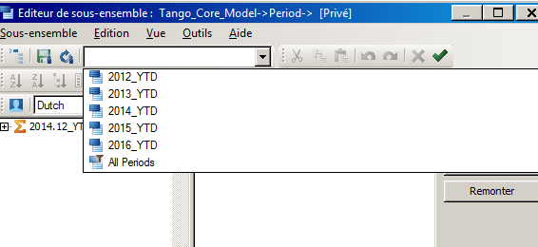
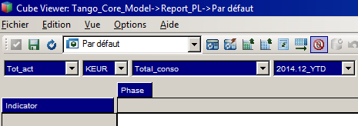
Exercise : Creation of a cube view (1/3)
EXERCISE
Steps :
Open the cube Report_PL
Select 2014.12_YTD in the Period dimension in the subset 2014_YTD
Move the Period dimension in Context
To move a dimension in context :
68 •
TANGO training

Slide 69
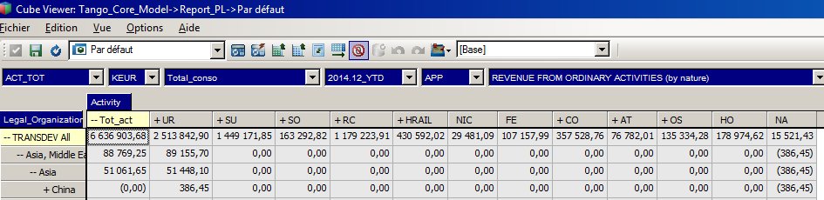
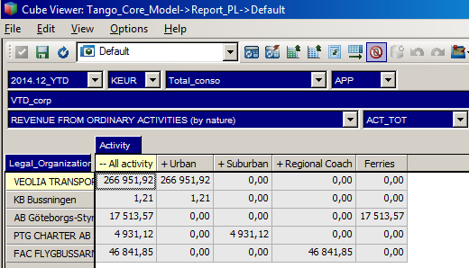

Exercise 4: Creation of a cube view (2/3)
EXERCISE
Steps :
Inverse Phase and Activity dimensions
Inverse Legal and Indicator dimensions
Refresh
Display activity name
Filter by level on legal organization dimension (only level 0 = entities), Make sure that all hierarchy is displayed
69 •
TANGO training

Slide 70


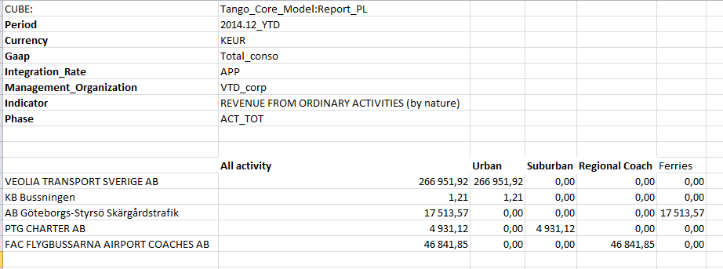
Exercise 4: Creation of a cube view (3/3)
EXERCISE
Steps :
Save your cube view
Export it in slice format
Save and customize your report in Excel
70 •
TANGO training

Slide 71
Report Customizing – best practices
1. For Context Dimensions, Data Analysis Scope → one single choice by dimension
3. Column Dimensions
(e.g. Period, Phase, GAAP)
Context
Columns
Lines / Rows
Lines / Rows
Data
2. Rows Dimensions:
Data Analysis values / Dimension to be drilled
(KPI’s or Financial Indicators, Mgmt Organizations, legal, Activities)
71 •
TANGO training

Slide 72
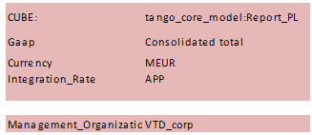



Report Customizing – exemple
Context
=SUBNM("tango_core_model:Currency";"";"MEUR")
Columns
=DBRW(Cube;Activity;Currency;Gaap;Integration_rate;Legal_organization;Management_organization;Period;Phase;Indicator)
Rows
Data
=DBRA("tango_core_model:indicator"; "TPL10_dest"; "English ")
72 •
TANGO training

Slide 73
Report Customizing – best practices
Basics
A report is based on a Cube
Dimensions to be analysed in Rows if possible
If dimensions elements must be restricted use a subset
A report is based on Elements Codes not Elements Aliases (versatil)
Codes will then be hidden
Name context variables in Excel to make the Tm1 formulas User Friendly
For data retrieve use DBRW
A dynamic report Build in Tango must be stored in Tango environment …not locally
If a dimension must be filtered : use an active form in a separated worksheet or use an MDX function
Cubes RP_Vector RP_PL or Report_PL (faster)
Prefer public subsets if the report must be shared
73 •
TANGO training

Slide 74





Report Customizing – best practices
Where are the functions explained (names, parameters) …?
Reminder Usefull Functions
DBRW
SUBNM
DBRA
DIMNM
ELPAR
DIMSIZ
DNEXT
ELCOMP
ELCOMPN
SUBSIZ
DIMSIZ
VIEW
74 •
TANGO training

Slide 75
Contacts
Questions about using Tango and loading data : support.tangofrance@transdev.com
Questions about data : Fabienne Caussidou or Marie Nicollet
Finance Community documents : https://lehub.sharepoint.com/sites/Expert.NET/Communities/Finance_community/Tango/Forms/AllItems.aspx?web=1
75 •
TANGO training

